Slide 1
Logistics & Introduction
CptS 360 Systems Programming
School of Electrical Engineering and Computer Science
Washington State University
Hassan Ghasemzadeh (hassan.ghasemzadeh@wsu.edu)

Slide 2
General Information
Instructor
Hassan Ghasemzadeh; Office: EME 131
Office hours: Tuesdays 3pm to 4pm or by appointment (simply send me an email)
Zoom info
Meeting ID: 920 9989 9866
Passcode: 929598
Direct link:
https://wsu.zoom.us/j/92099899866?pwd=KzlXR2dHaEhjbksydGE0Sm5JOTJiQT09
Same zoom meeting used for lectures and office hours

Slide 3
General Information
Teaching assistant
Mr. Mahdi Pedram (mahdi.pedram@wsu.edu)
TA may use a different Zoom meeting
Class webpage
https://eecs.wsu.edu/~hassan/360.html
You should check the official class webpage
Check 2-3 times a week
Updates about course schedule, assignments, readings, TA, office hours, tests, sample questions if any, deadlines, discussion sessions, no-class days

Slide 4
General Information
I will not always announce assignments so you will need to track this on your own and be on top of the trash!
I plan to prepare and post slides on topics that will be covered in this course
The slides will be posted in WSU Blackboard
We will also use WSU Blackboard for submitting assignments and for reporting your grades

Slide 5
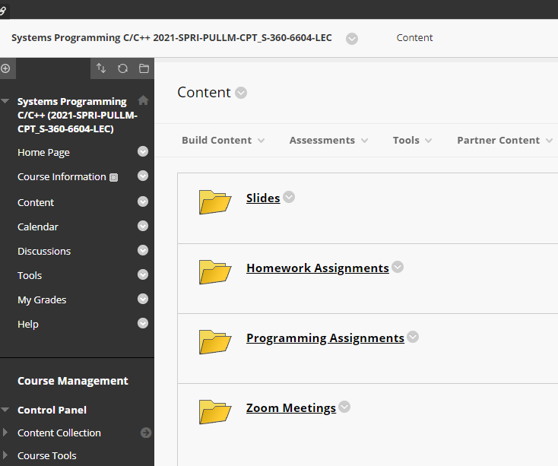
WSU Blackboard
Use different folders to access Zoom link and recordings, assignments, and slides.

Slide 6
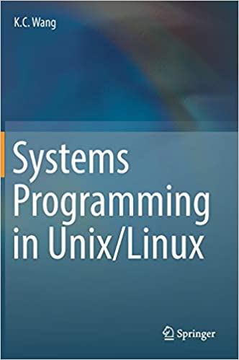
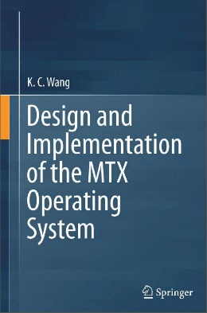

Textbooks
Main textbooks
Systems Programming in Unix/Linux, K.C. Wang, Springer International AG, 2018
Design and Implementation of the MTX Operating System, K.C. Wang, Springer International AG, 2015
Additional textbooks
Operating System Concepts, 10th Edition, Abraham Silberschatz, Greg Gagne, Peter B. Galvin, ISBN: 978-1-119-32091-3, April 2018, 1040 Pages

Slide 7
Grading
Programming/lab assignments 30%
Homework assignments 10%
Midterm exam 30%
Final project 30%
No final exam
Final letter grades are calculated according to this table
Percentage grade threshold | Letter grade
90 (total points >= 90) | A
87 | A-
83 | B+
80 | B
77 | B-
73 | C+
70 | C
67 | C-
63 | D+
60 | D
< 60 | F
Midterm will be on March 4th during class hours through Zoom

Slide 8
Study Groups
Not mandatory!
Team up with your classmates to study
Student volunteers to coordinate meetings
Highly recommended (based on positive feedback from students)
Email one coordinator to join their team for study

Slide 9
Labs
There will not be a formal lab session
You will work on programming assignments on your own
You will demo your program / results to the TA through Zoom
Not all labs require demoing your work to the TA
The description of the assignment states if a demo is required

Slide 10
Course Contents
Topics Covered
Introduction to Unix/Linux and Operating Systems
Program development
Execution image of C programs
File Input/Output (I/O)
File Control
Standard I/O Library
File system implementation
Processes
Process Control
Process Synchronization and Communication
Concurrent Programming
Networking

Slide 11
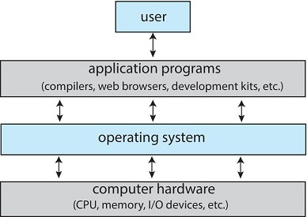
What is an operating system?
Software that manages a computer's hardware
A program that acts as an intermediary between user and hardware
Operating system goals:
Execute user programs and make solving user problems easier
Make the computer system convenient to use
Use the computer hardware in an efficient manner

Slide 12
Unix
Origin
Unix is a general-purpose operating system developed in 1970sh
Developed by Ken Thompson and Dennis Ritchie
This initial development is often referred to as Unix V6
There are multiple versions of Unix developed by various companies
AT&T Unix, referred to as System V
Berkeley Unix, referred to as BSD (Berkeley Software Distribution)
HP developed another version called HP-UX
IBM Unix is referred to as AIX
Sun Microsystems has its own version of Unix called Solaris

Slide 13
Linux
Motivation
Most versions of Unix mentioned before are proprietary
They work on particular hardware platforms only
Hard to do systems programming on general purpose computers (ordinary users don’t have access to the proprietary hardware/software)
Linux is a Unix-like operating system
Started as an experimental kernel
Linus Torvalds in 1991
Free to use
Predominantly used with x86 platforms but has been also ported to other platforms such as Motorola, SPARC and ARM

Slide 14
Ubuntu Linux
There are several versions of Linux such as Debion, Ubuntu, Mint, etc.
We will focus on Ubuntu Linux in this course due to its popularity, ease of use, and good use community
Linux installation
Linux can be installed on most PCs (intel architectures)
Laptop
Desktop
Alternatively, one can install virtual machines in your current window OS and then install Linux in your virtual machine
VirtualBox is one of the most popular virtual machines
VMware is another environment to use

Slide 15
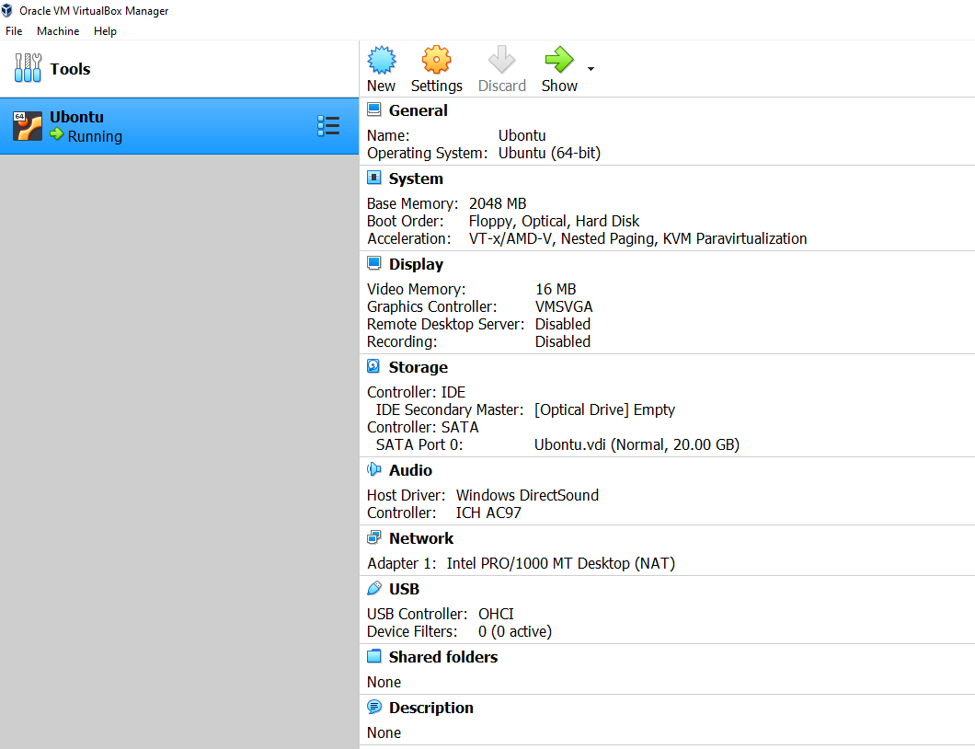
Virtual Box
Here is a screenshot of how Virtual Box looks like on my computer

Slide 16
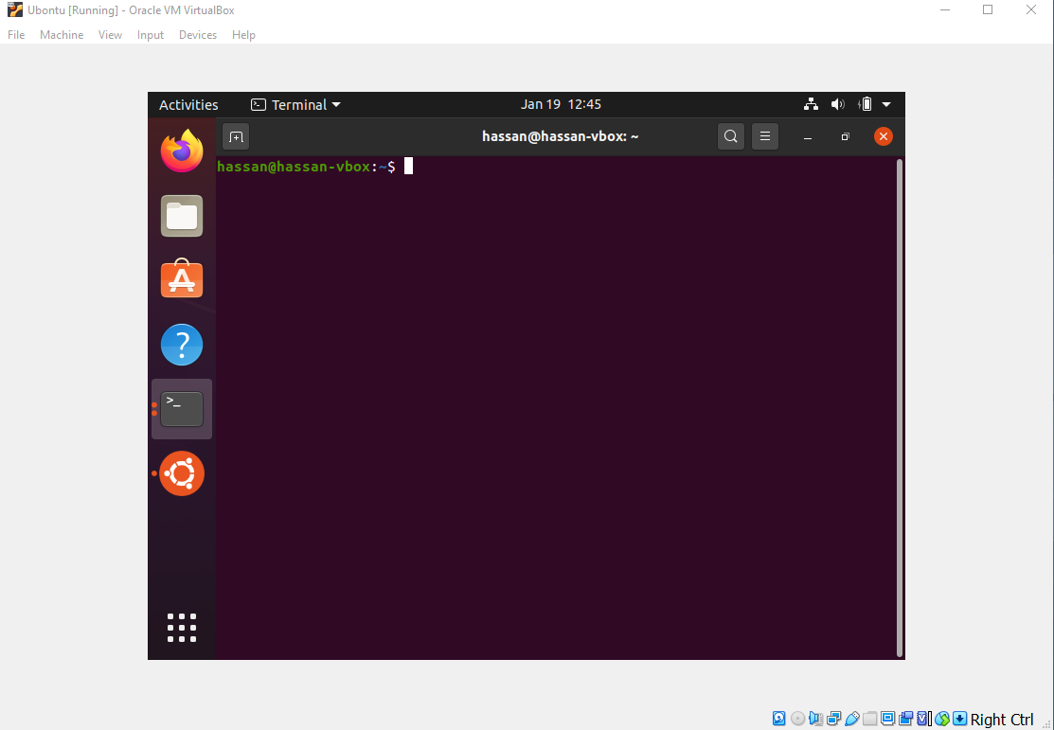
Ubuntu
Ubuntu installed in Virtual Box environment

Slide 17
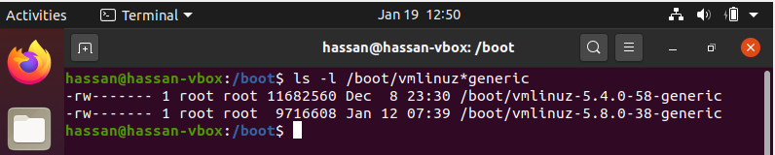
Linux Kernel
Kernel is the control program of the operating system
Kernel is compiled into a binary or kernel image
Bootable kernel images are named similar to this:
vmlinuz-VERSION_NUMBER-generic
File is located under /boot directory
Bootable kernel image has three pieces:
| BOOT | SETUP | linux kernel |
When the computer starts, a booter program loads the kernel image into the memory
Notes:
About the three fields of the kernel image file:
BOOT is a 512-byte booter for booting early versions of Linux from floppy disk images. It is no longer used for Linux booting but it contains some parameters for SETUP to use. SETUP is a piece of 16-bit and 32-bit assembly code, which provides transition from the 16-bit mode to 32-bit protected mode during booting.

Slide 18
Ubunto
Advantages of using Ubunto
Easy to install. It can be installed online if the user has connection to the Internet.
Easy to install additional software packages by
sudo apt-get install PACKAGE
It is updated and improved regularly with new releases.
It has a large user base, with many problems and solutions posted in discussion forums online.
It provides easy connections to wireless networks and access to the Internet.
Sudo commend
You usually work with ordinary account and use sudo to execute a command with super-use (root) access

Slide 19
Some special features of Ubuntu
To run any privileged commands, the user must enter
sudo command
The user’s PATH environment variable does not include current directory. To include the current directory, add this line to .bashrc
PATH=$PATH:./
When user opens a terminal, sh will execute the .bashrc file first to set PATH to include the current working directory ./
Many users may have installed 64-bit Ubuntu Linux. Some of the programming exercises and assignments in this course are intended for 32-bit machines. In 64-bit Linux, use the following command to generate 32-bit code. If the 64-bit Linux does not take the -m32 option, the user must install additional support for gcc to generate 32-bit code.
gcc -m32 t.c # compile t.c into 32-bit code

Slide 20
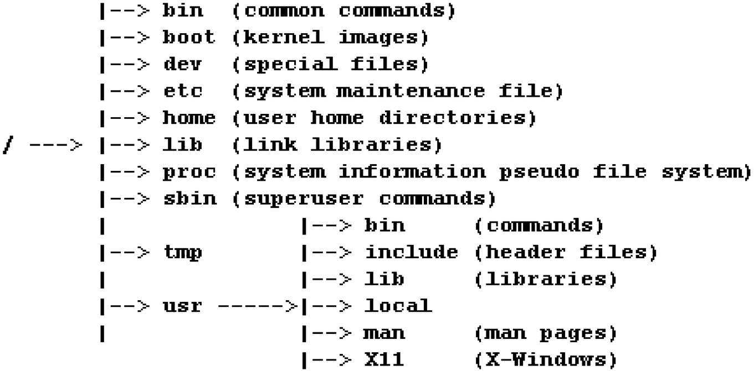
File system organization
File system is organized as a tree

Slide 21
File types
Unix/Linux considers everything that can store or provide information as a file
Depending on the usage of the ‘file’ there are different types of files
There are three different file types
Directory files
A directory may contain other directories and (non-directory) files.
Non-directory files
Regular files
Special files
Symbolic files

Slide 22
File types
Non-directory files
Regular files
Contain either ordinary text or executable binary code.
Special files
Entries in the /dev directory.
Represent I/O devices, which are further classified as
CHAR special files: I/O by chars, e.g., /dev/tty0, /dev/pts/1
BLOCK special files: I/O by blocks, e.g., /dev/had, /dev/sda
Symbolic files
These are regular files whose contents are pathnames of other files.
Pointers to other files. Example:
ln -s aVeryLongFileName myLink

Slide 23
Linux commands
Make yourself with these commands
ls: ls dirname: list the contents of CWD or a directory
cd dirname: change directory
pwd: print absolute pathname of CWD
touch filename: change filename timestamp (create file if it does not exist)
cat filename: display file contents
cp src dest: copy files
mv src dest: move or rename files
mkdir dirname: create directory
rmdir dirname: remove (empty) directory
rm filename: remove or delete file
ln oldfile newfile: create links between files
find: search for files
grep: search file for lines containing a pattern
ssh: login to remote hosts
gzip filename: compress filename to .gz file
gunzip file.gz: uncompress .gz file
tar –zcvf file.tgz . : create compressed tar file from current directory
tar -zxvf file.tgz . : extract files from .tgz file
man: display online manual pages
zip file.zip filenames : compress files to .zip file
unzip file.zip : uncompress .zip file
‘man’ pages can be used to learn about the commands

Slide 24
User accounts
User accounts are maintained in the /etc/passwd file, owned by root but readable by anyone.
Each user has a line in the /etc/passwd file of the form
loginName:x:gid:uid:usefInfo:homeDir:initialProgram
second field ‘x’ indicates checking user password
Encrypted user passwords are maintained in the /etc/shadow file.
When a user tries to login with a login name and password, Linux will check both the /etc/passwd and /etc/shadow files to authenticate the user.

Slide 25
Add new users
No need for most users who run Ubuntu on their personal PCs or laptops.
Ubuntu supports an adduser command, which can be run as
sudo adduser username
It adds a new user by creating an account and also a default home directory /home/username for the new user.

Slide 26
Readings and assignments
A lot to learn this semester. Start Today!
Read chapter 1 of the systems programming textbook
Homework assignment #1 (HW1) is posted in Blackboard and is due next week
Programming assignment #1 (L1) is posted in Blackboard and is due next week

